Slide 1
Office Supplies Telephone Campaign Analysis
BY:
Abulla O. Othow
Los Angeles CA
Phone: 323-740-2626
website: https://kogilo.github.io/
Github: https://github.com/kogilo
E-mail: getabullaothow@gmail.com

Slide 2

Contents
Background
Objectives
Methodology
Exploratory Data Analysis (EDA)
Analysis Results
Recommendations
Appendix
OFFICE CORP

Slide 3
Background
Office Supplies PLC has conducted a marketing campaign and has generated real response data from the analysis
During the campaign about 16,000 of the customers were targeted.
Client wants to use response data from prior campaign to maximize potential of the next campaign
Develop models
Understand targeting
Targeting all customers would cost $1.4M against the 100k customer base
Office Corp response data snapshot:
Historical sales
Prior campaign sales
List of targeted customers:
# of Employees
Prior products purchased
Date of first purchase
OFFICE SUPP. PLC

Slide 4

Objectives
Develop a couples of models
Find the customers responding to the campaign
Make use of Model Logistic Regression and Linear Regression.
Find the probability of responding to the campaign.
Design a lift-chart
OFFICE SUPP. PLC

Slide 5
Methodology
Clean the data
Perform EDA on dataset
Transform dataset
Bucketing
Imputing
Feature engineering
Perform data model creation
Logistic Regression to determine probability of response
Linear Regression to determine likely size of purchase
Calculate profitability based on regression outputs, gross margin, and campaign and transaction cost
Define customer deciles
Create lift table
Deliver recommendation
OFFICE SUPP

Slide 6
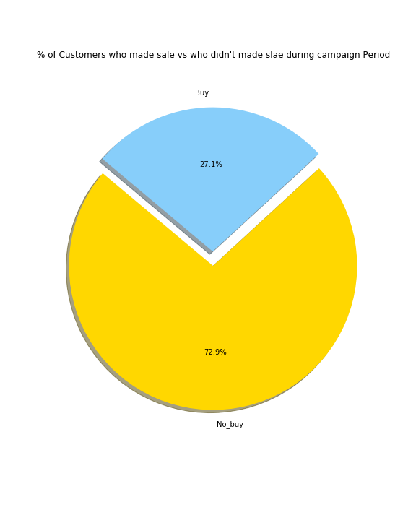
EDA Customers how responded vs not responded
OFFICE CORP

Slide 7
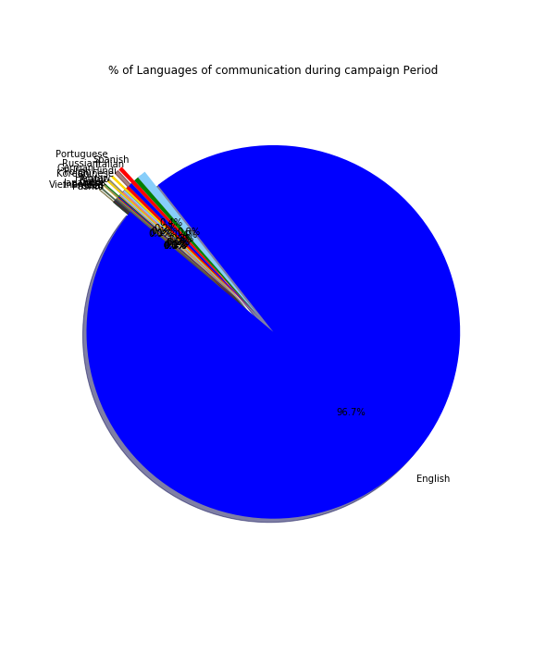
EDA Languages of the interview
OFFICE CORP

Slide 8
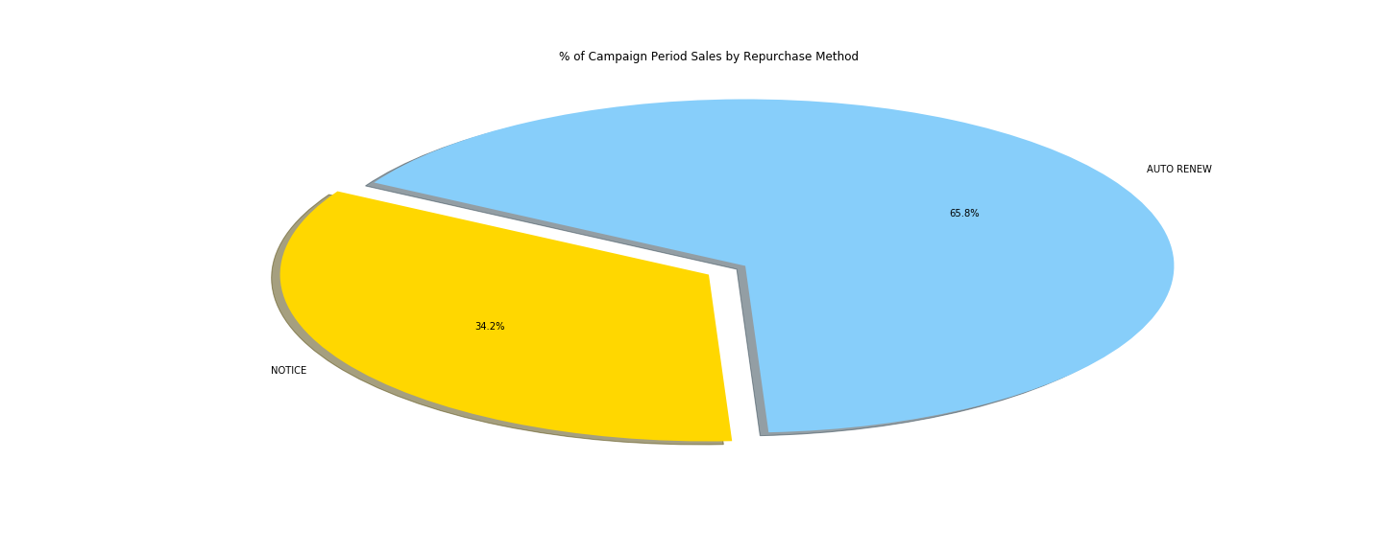
EDA Purchasing methods
OFFICE CORP

Slide 9
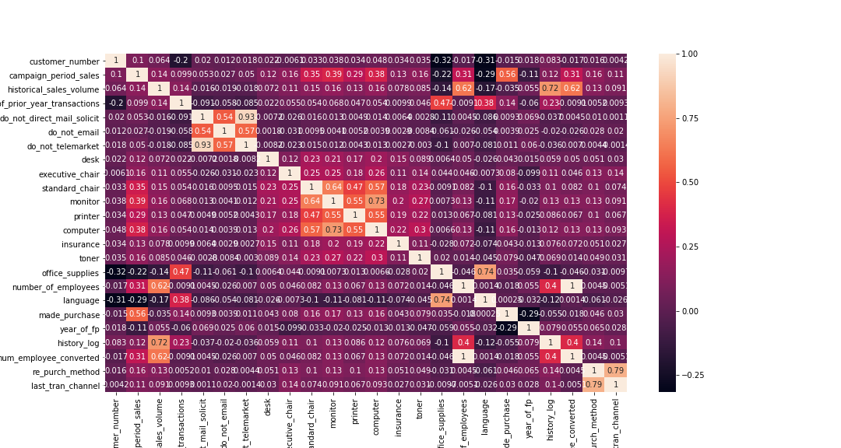
EDA COORELATION HEATMAP
OFFICE CORP

Slide 10
Stepwise Logistic Regression
Independent Validation Sample Size 6,536
Significant Variables:
High Historical Sales Volume
Large # of Prior Year Transactions
Purchased Computer
Purchased Monitor
Purchased Office Supplies
Purchased Printer
Non Auto-Renew or Notice Repurchase Method
Purchased Standard Chair
OFFICE SUPP

Slide 11
Stepwise Linear Regression
Significant Variables:
Greater # of Prior Year Transactions
Purchased Monitor
Greater # of Employees
Purchased Office Supplies
Non-Branch Last Transaction Channel
High Historical Sales Volume
Long Tenure
OFFICE CORP

Slide 12
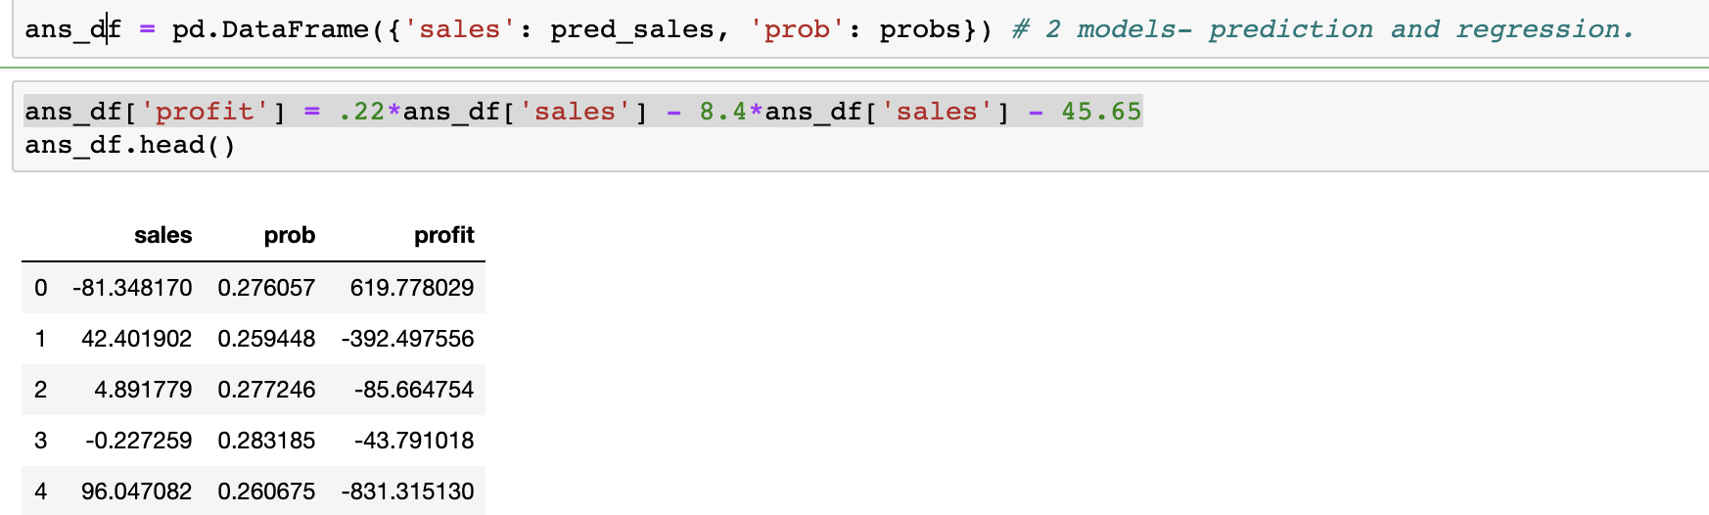
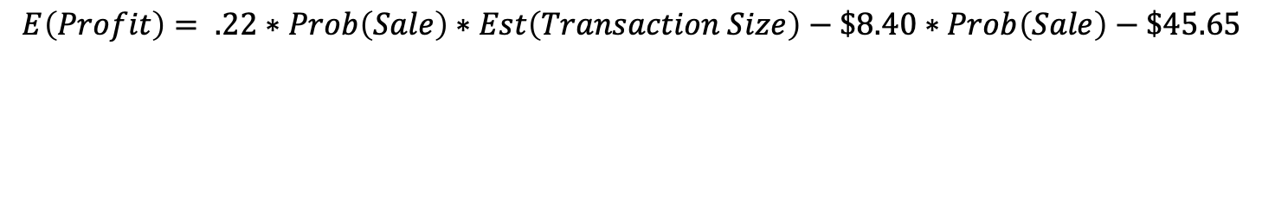
Profitability Model
Gross Margin on Sales: 22%
Campaign Cost: $45.65 per business contacted
Transaction Cost: $8.40 per transaction
$$E\left(Profit\right)= .22∗Prob\left(Sale\right)∗Est\left(Transaction Size\right)−\$8.40∗Prob\left(Sale\right)−\$45.65$$
OFFICE CORP

Slide 13
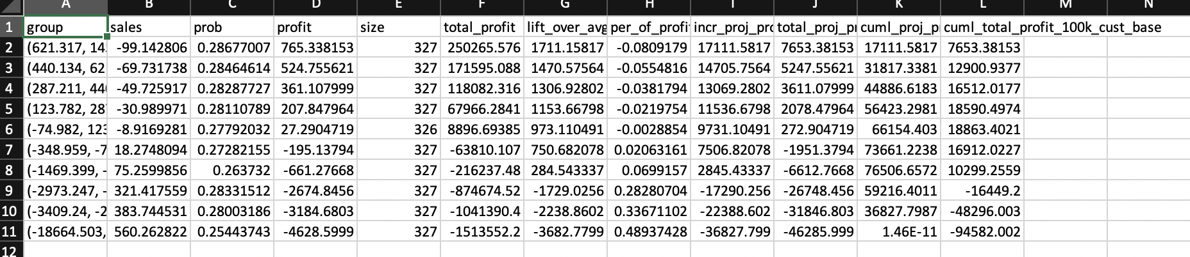
Lift
OFFICE CORP

Slide 14
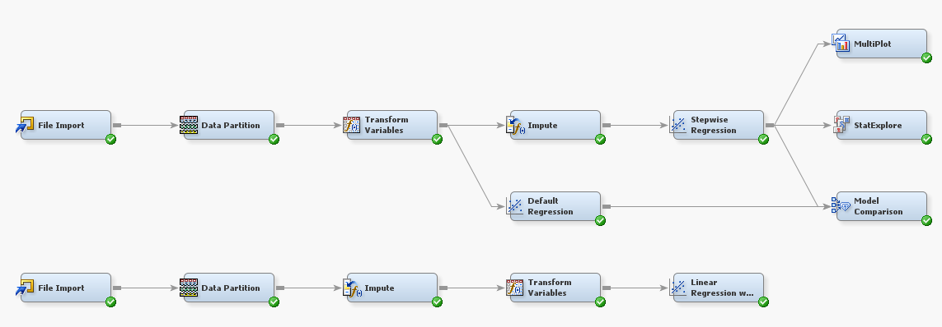
Appendix 1 - Model
OFFICE CORP

